Slide 1

CREDIT CARD
WEEKLY STATUS REPORT

Slide 2
Project Objective:
To build a weekly credit card analytics dashboard that tracks key performance metrics and emerging trends in real time, enabling stakeholders to evaluate operational performance efficiently.
Project Overviews:
This report presents a Power BI based analysis of credit card weekly performance. The dashboard consolidates transactional and customer level data to provide actionable insights into revenue, customer behavior, and operational trends.

Slide 3
Problem Statement
Credit card operations generate large volumes of data on a weekly basis. Without a centralized analytical view, it becomes difficult for stakeholders to track performance, identify trends, and take timely decisions. This project addresses the need for a structured and visual analytics solution.
Data Description / Data Source(mysql database)
The dataset used in this project includes credit card customer and transaction data with attributes such as card category, annual fees, activation status, acquisition cost, and weekly time periods. The data was cleaned, transformed, and modeled in Power BI for analysis.
Key Performance Indicators (KPIs)
  The dashboard highlights key performance indicators such as:
  Total Interest
  Total Transactions amount
  Total Transactions Count
  Total Revenue
  Avg Css

Slide 4
DAX QUERIES
Age Grooup = SWITCH(
TRUE(),
'cc_db cust_detail'[Customer_Age]<30,"20-30",
'cc_db cust_detail'[Customer_Age]>=30 && 'cc_db cust_detail'[Customer_Age]<40,"30-40",
'cc_db cust_detail'[Customer_Age]>=40 && 'cc_db cust_detail'[Customer_Age]<50,"40-50",
'cc_db cust_detail'[Customer_Age]>=50 && 'cc_db cust_detail'[Customer_Age] <60 ,"50-60",
'cc_db cust_detail'[Customer_Age]>=60,"60+",
"Unknown"
)

Slide 5
IncomeGroup = SWITCH(
TRUE(),
'cc_db cust_detail'[Income] < 35000,"Low",
'cc_db cust_detail'[Income] >= 35000 && 'cc_db cust_detail'[Income]<=70000,"Mid",
'cc_db cust_detail'[Income] > 70000,"High",
"Unknown"
)
Revenue = 'cc_db cc_details'[Annual_Fees]+ 'cc_db cc_details'[Total_Trans_Amt] +'cc_db cc_details'[Interest_Earned]

Slide 6
current_week_revenue = CALCULATE(SUM('cc_db cc_details'[Revenue]),
FILTER(ALL('cc_db cc_details'),
'cc_db cc_details'[WeekNo] = MAX('cc_db cc_details'[WeekNo])))
previous_week_revenue = CALCULATE(SUM('cc_db cc_details'[Revenue]),
FILTER(ALL('cc_db cc_details'),
'cc_db cc_details'[WeekNo] = MAX('cc_db cc_details'[WeekNo])-1))
WOW Revenue = DIVIDE(([current_week_revenue]-[previous_week_revenue]),[previous_week_revenue])

Slide 7
Current week trans
current_week_transaction = CALCULATE(SUM('cc_db cc_details'[Total_Trans_Amt]),
FILTER(ALL('cc_db cc_details'),
'cc_db cc_details'[WeekNo] = MAX('cc_db cc_details'[WeekNo])))
previous week trans
current_week_transaction = CALCULATE(SUM('cc_db cc_details'[Total_Trans_Amt]),
FILTER(ALL('cc_db cc_details'),
'cc_db cc_details'[WeekNo] = MAX('cc_db cc_details'[WeekNo])-1))
WOW transaction
WOW transaction = DIVIDE(([current_week_transaction]-[previous_week_transaction]),[previous_week_transaction])

Slide 8
current_week_transaction_Count
current_week_transaction_Count = CALCULATE(SUM('cc_db cc_details'[Total_Trans_Ct]),
FILTER(ALL('cc_db cc_details'),
'cc_db cc_details'[WeekNo] = MAX('cc_db cc_details'[WeekNo])))
WOW transaction_coun
previous_week_transaction_Count = CALCULATE(SUM('cc_db cc_details'[Total_Trans_Ct]),
FILTER(ALL('cc_db cc_details'),
'cc_db cc_details'[WeekNo] = MAX('cc_db cc_details'[WeekNo])-1))
WOW transaction_coun
WOW transaction_count = DIVIDE(([current_week_transaction_Count]-[previous_week_transaction_Count]),[previous_week_transaction_Count])

Slide 9
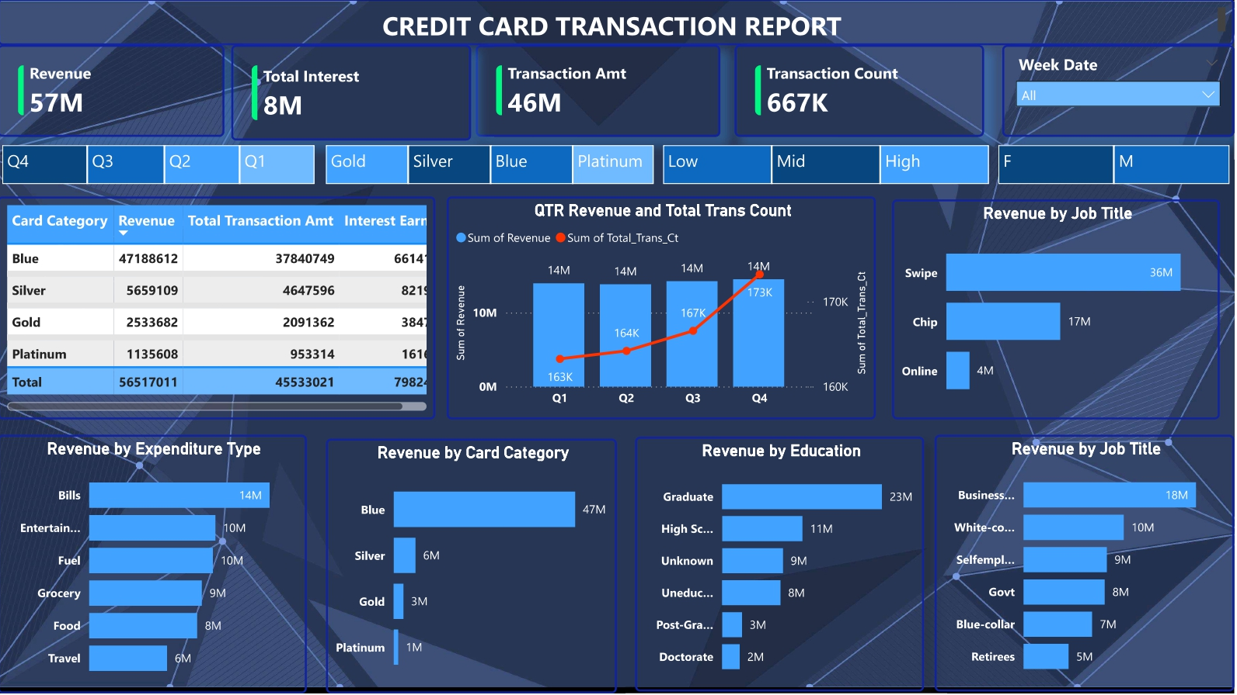

Slide 10
